Slide 1
Forge VR Explorer
Shawn Cross
Griffin Gonsalves
Paul Kwak

Slide 2
Main Purpose
Use Vrok.it and Forge API
Increase usability and add slightly more functionality
Upload CAD files
File conversion
Model viewing
VR with Google Cardboard

Slide 3
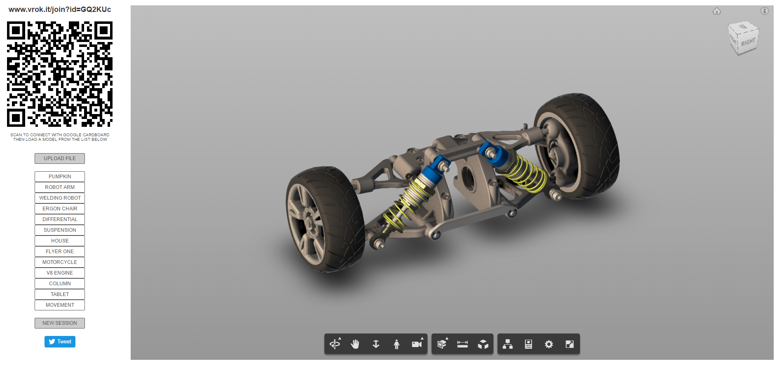

Slide 4
Overview
Requirements
Design
Week by week break down
Problems & Solutions
What’s next?

Slide 5
Requirements
Forge API Related
Model Viewing – Forge Viewer
Authentication
Data Management
Model Derivative
Non-related
File upload
Smartphone Connection
VR Device Support

Slide 6
Forge VR Explorer Functionality
User can choose a CAD model locally or through Data Management
3D model is shown through Forge Viewer
Connect to website with smartphone (via QR scanner)
Model can be viewed through Google Cardboard
Viewable model has interactivity

Slide 7
Authentication Requirements
Security for users
Token created for users

Slide 8
Viewing VR Requirements
Model is viewable in VR headset (Google Cardboard)
High quality/size models will be hard to view
Models need some interactivity while user uses VR

Slide 9
File Upload Requirements
User can upload files
Through local machine
Or A360 (Data Management API)
Failures will be reported
Unsuccessful upload
Too large
File will be displayed on list of usable models

Slide 10
Model Derivative Requirements
Files user uploads will be converted to SVF files
Then the file will be displayed on viewer
Should notify user of any failures

Slide 11
Smartphone Connection Requirements
Users connect phone to Vrok.it
So user can view model in VR environment
Users device must have QR scanner and internet
Phone should connect to site via QR scan

Slide 12
Data Management Requirements
Users with files in A360 should be able to use in site
User gives website permission to use files
User can now choose file to view

Slide 13
Model View Requirements
User can see chosen model on website
Model View uses SVF file format
Model cannot be too detailed or large
Where the website cannot run it
Model is displayed in Forge Viewer and is interactive
Model is manipulation

Slide 14
Design Document
A detailed explanation of the development process
Based on the IEEE 1016

Slide 15
Authentication Design
2 Legged
3 Legged
For when site does not need permission based resources
Simple token exchange system for security
Dependent on Autodesk endpoints/system/servers
When users must verify permission for resources
Users verify permission after logging in
Token returned granting site access of resources
Dependent on Autodesk endpoints/system/servers
User has account
As well as user permission

Slide 16
Viewing VR Design
Currently using Google Cardboard’s application
Android WebView inside the application (WebGL)
This allows for VR viewing of models on the site loaded by the QR scanner
Interactivity takes input from keyboard
Dependent on user having
Google Cardboard hardware
Google Cardboard application
Android Device Lollipop+

Slide 17
Data Management Design
Relies on 3 Legged Data Authentication being completed
User accesses files stored in A360 to use
Data management returns those files

Slide 18
Website Interface Design
NEW interface
Focus on user experience
Easy to use
Easy to find components
Needs to have:
Forge Viewer
File Upload
QR code
Model Derivative
Information and basic site content

Slide 19
Model View Design
Forge Large Model Viewer
Uses WebGL
Renders SVF model on webpage
Model is interactive
Components
Main view window
Listed Models
Model viewer navigation

Slide 20
Local File Upload Design
Select files on local machine
Site verifies file type
Returns success/failure
Conversion to SVF type
Components
Local Upload button
File selection
File type verification
File size verification
File conversion

Slide 21
Non Local File Upload Design
Login to Autodesk account
Give site permissions
Directed to A360 for file selection
Component
File type verification
File size verification
File conversion

Slide 22
Model Derivative Design (File Conversion)
Uploaded files (local or not) sent
API accepts CAD files
Failure is notified to user
Success results in converted SVF file

Slide 23
Smartphone Connection Design
Assumptions
User has “smartphone”
User has internet access
User has QR scanner
Mobile device can access site with QR scanner
Components
QR code
Device view

Slide 24
Heroku
Moved project to Heroku
Takes care of the most back end things
Easy to setup
Vrok.it also utilized
Free!

Slide 25
Getting The Website Set Up
Installed heroku and node.js
Edited the credentials in the js files
Created a bucket for files
Filled bucket with some Test files

Slide 26
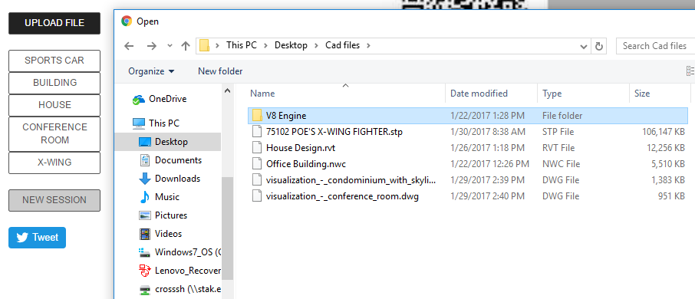
Local File Upload
Model derivative accepts roughly 60 different types of files.
Files Uploaded will be placed in the list of viewable models.
Once successfully uploaded the files will be loaded into the viewer.
Files uploaded will be placed in the
bucket temporally.

Slide 27
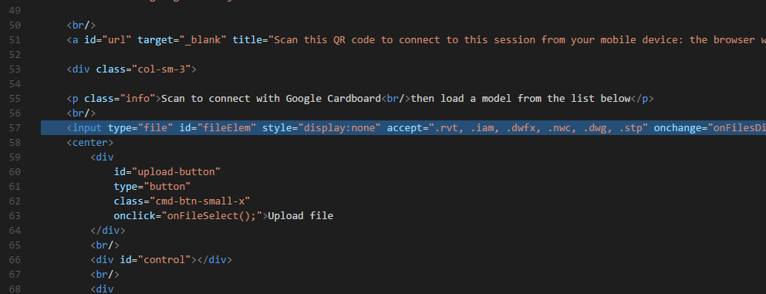
Local File Restriction
Used the html accept attribute to restrict the file types
Only files of the types listed will show up in the file explorer

Slide 28
Node.js
Asynchronous
Server side
Used by vrok.it and API

Slide 29
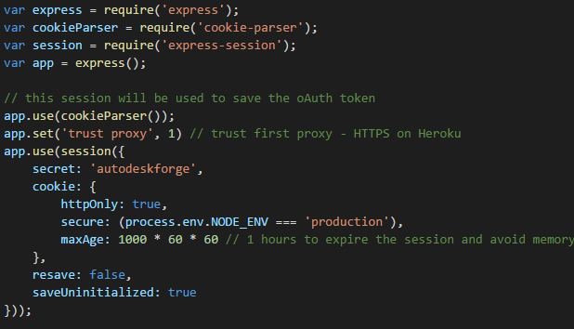
Express.js
Utilized by Vrok.it and API already
Node.js web app framework
Matches on request sent to server

Slide 30
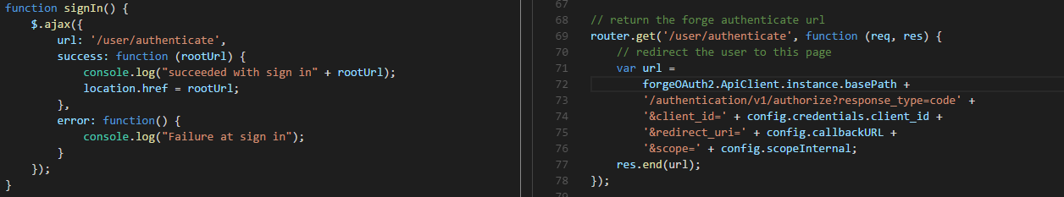
3-Legged Authentication
Url matches and calls function to give url that redirects to Autodesk
Receive URL and redirect to Autodesk to receive token.
Not working as it should…

Slide 31
Non Local File Navigation
Displayed in a file tree
User will be able to navigate to any files in their online storage from Autodesk
Selected Files willed be uploaded to the website
Autodesk API being used

Slide 32
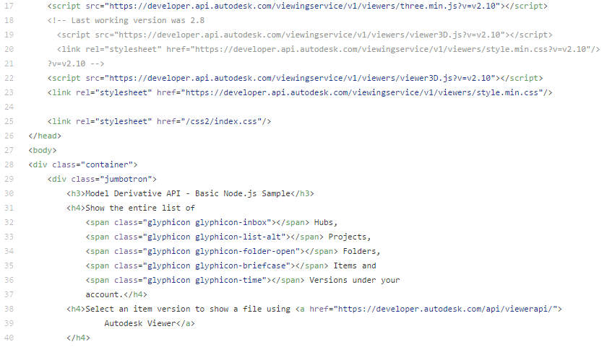
Website Layout
Delays caused challenges
Confusing code
Server backend with Node.js
Multiple CSS files and html index files

Slide 33
Week by week summary

Slide 34
Winter Week 1
Began to get the website set up
Planned on using github.io

Slide 35
Winter Week 2
Website was more difficult to get setup than we initially thought
switched from using github.io to heroku for server needs
Had to swap out credentials to get site to work properly
Site up and running

Slide 36
Winter Week 3
Troubles setting up file bucket (never used curl before)
Got the bucket setup that will hold the files
Met with Kean and Patti

Slide 37
Winter Week 4
Local file restriction complete
Began working on 3-legged Authentication
Found this would be very hard to do from scratch
Found an API that did exactly what we want
Spoke with Kean about the API we found and decided it would be best to integrate that

Slide 38
Winter Week 5
Began Integration of API
Ran into many problems with the integration
Kean suggested that he could bring in the person that created the API to help

Slide 39
Winter Week 6
Continued to work on integration
Worked on revision for documents to reflect where the project is currently

Slide 40
Problems Solutions
Low communication with client
Not enough questions on our side
Not enough time on theirs
Team work
Better planning
Better communication
Faster help seeking
Client
More question asking
Weekly meetings with client?
Team
More planning
Delegation?
Weekly meetings
Seeking help sooner

Slide 41
What’s next?
Finish the integration of the API
Begin changes to the UI
Testing?

Slide 42
References
https://developer.autodesk.com/
https://github.com/KeanW/vrok-it
https://github.com/Autodesk-Forge/model.derivative-nodejs-sample

